Slide 1
Aimsun Next – Carla Integration

Slide 2

Basic information
This interface allows Aimsun’s traffic agents to be represented in CARLA and vice versa enabling advanced traffic and vehicle behavior studies.
This interface is a python script that utilizes the API utility of Carla and uses External Agent Interface of Aimsun next to establish a connection.
The connection is created with a python script.
This utility is currently a work in progress

Slide 3




High level overview
Carla-controlled vehicle information for next time step
TCP/IP
Aimsun-controlled vehicle information for next time step

Slide 4
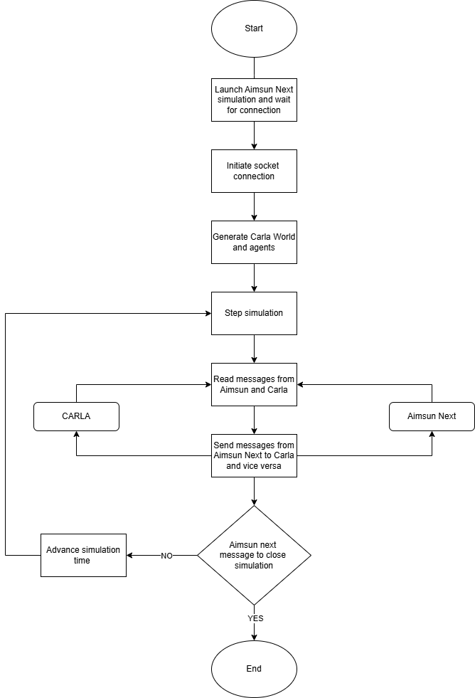
Flowchart

Slide 5
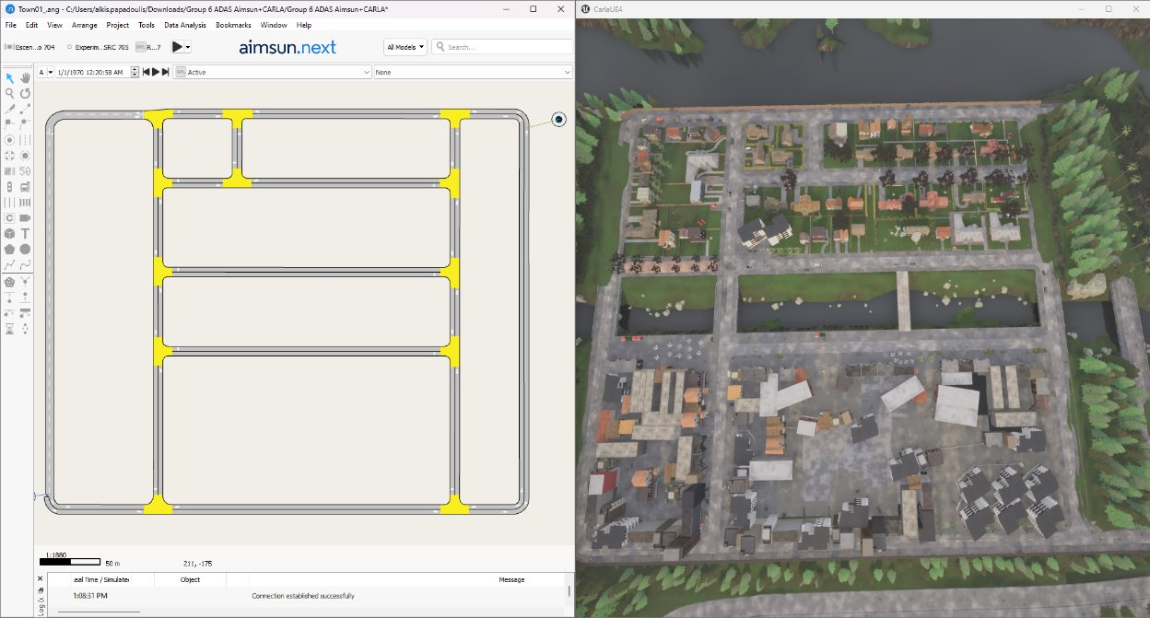
How the platform works
Prerequisites:
The map for the simulation should exist in the two software with the exact same coordinates (you can import opendrive maps in Aimsun Next)
The two software should have the exact same simulation time step (This should be set in the Carla script and in Aimsun Next)
The python script should be placed inside the Carla API folder (e.g CARLA_0.9.15\WindowsNoEditor\PythonAPI\examples)

Slide 6
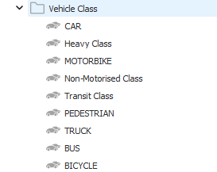
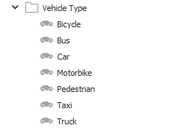
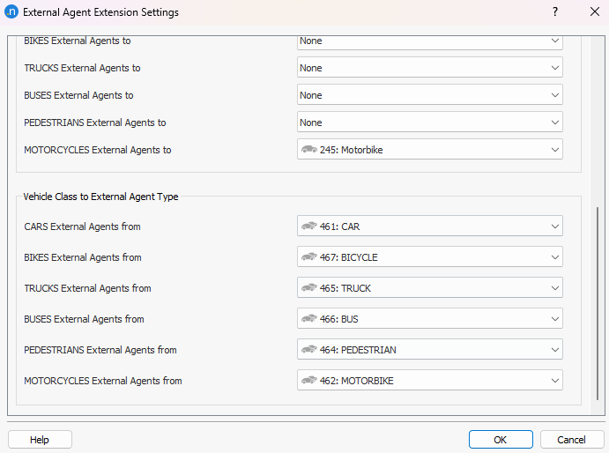
What needs to be set up in Aimsun Next prior to the simulation
All vehicle types: CAR, BUS, TRUCK, PEDESTRIAN, MOTORBIKE, BICYCLE, need to have their own Vehicle Type and Vehicle Class in order to be properly reflected in Carla.
Once they have been set up, they must be set in the External Agent API Menu as below

Slide 7
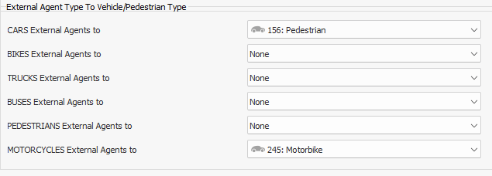
What needs to be set up in Aimsun Next prior to the simulation
All vehicle types present in the Aimsun Next demand must be present in the “External Agent Type to Vehicle/Pedestrian Type menu of the External Agent API UI

Slide 8
What needs to be set up from Carla’s side
The interface consists of two main scripts:
aimsun_eai_controller.py
b) ExternalAgentsConnector_pb2.py that has the structure of the protobuff messages that are being exchanged with Aimsun Next
Has all Carla settings and connection logic
Should not be changed

Slide 9
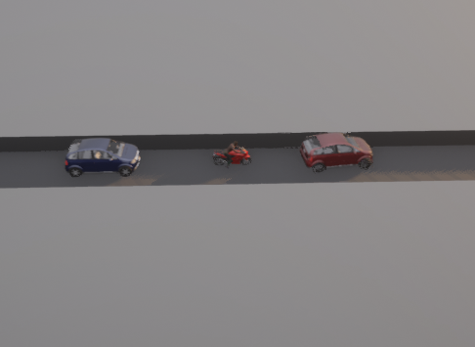
What needs to be set up from Carla’s side
Within the aimsun_eai_controller.py script you can set:
The map to be loaded by Carla
Spectator camera locations
CAV equipment and logic
Blueprints for all vehicle types from Aimsun
Simulation time step

Slide 10
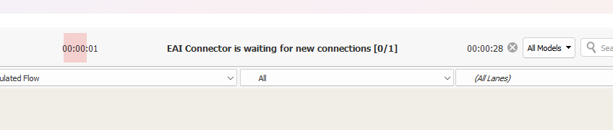
How do you launch the co-simulation?
Start Aimsun Next
Start Carla
Launch Aimsun Next simulation
Wait for the message “EAI Connector is waiting for new connections”
Launch the python script that creates the connection between Carla and Aimsun
Wait for the simulation to finish or wait for error messages ☺

Slide 11
Demonstration

Slide 12
Questions

